Slide 1

AKS Office Hours
Kendall Roden
Cloud Native Technical Specialist
Kendal Roden
Cloud Native Technical Specialist
Dave Strebel
Cloud Native Technical Specialist

Slide 2
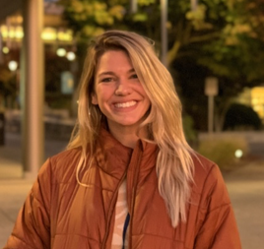
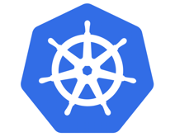


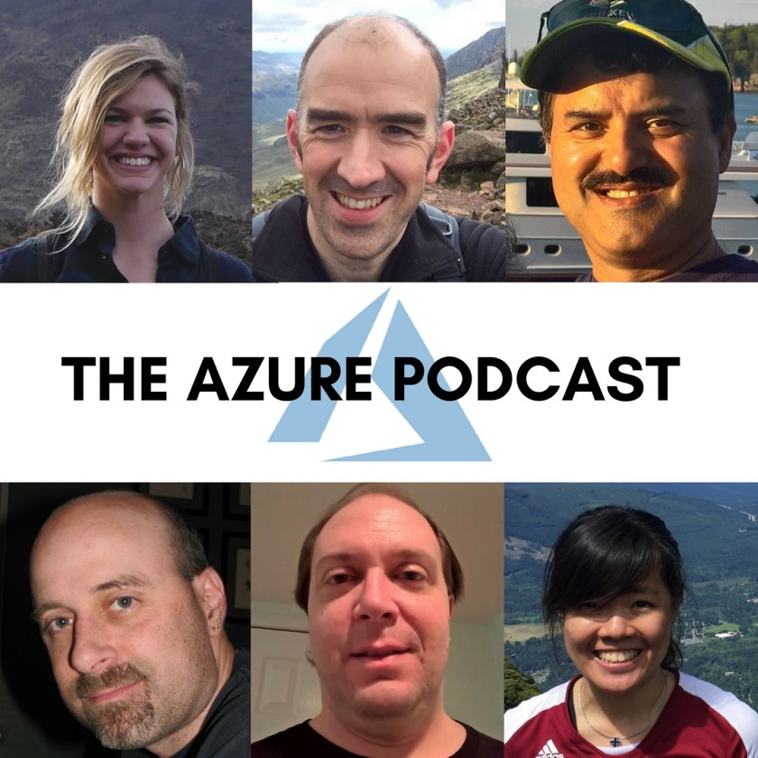

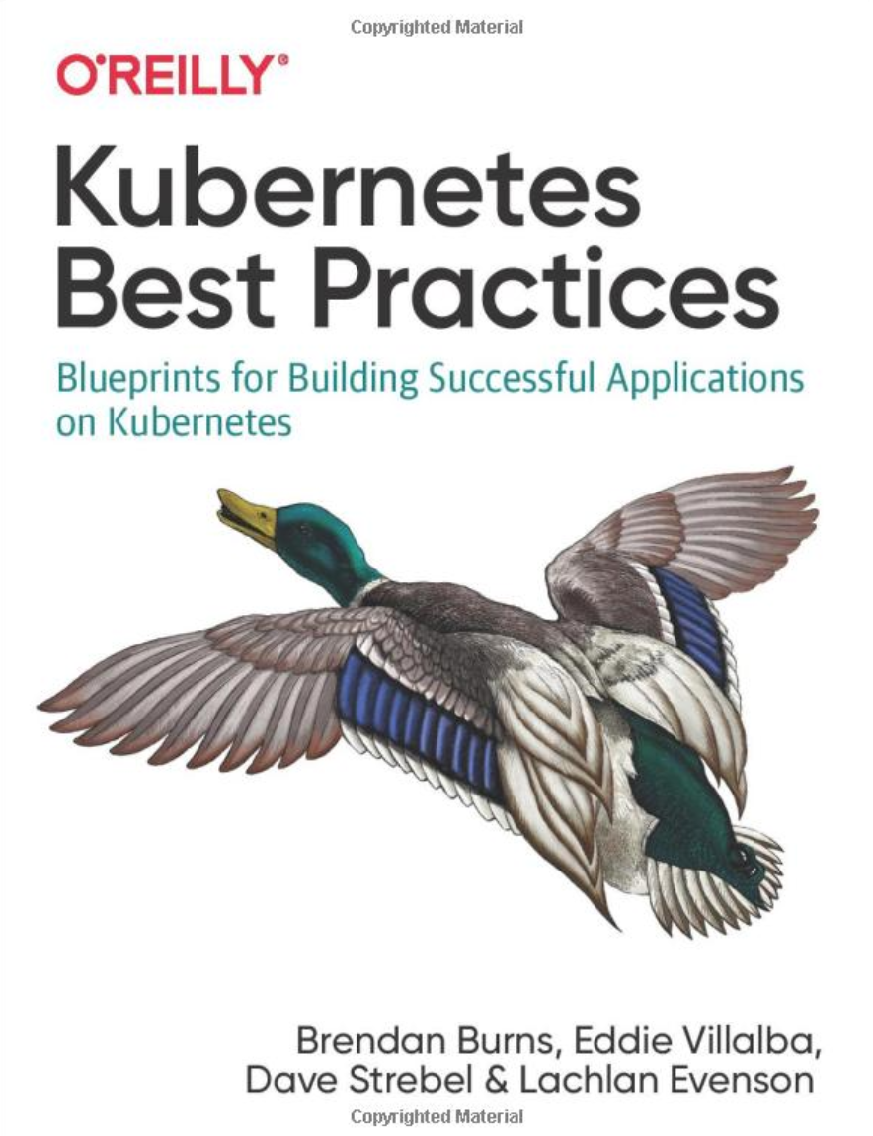
Who are we?
@kendallroden​
@dave_strebel​

Slide 3
Why AKS Office Hours?
Provide AKS customers with updates pertaining to AKS and the Cloud Native Ecosystem
Host a short talk and/or demo on Cloud Native technologies related to Kubernetes and AKS
Collect feedback from customers on issues, blockers, use cases, and questions related to AKS

Slide 4
What to expect
Call agenda
10 minutes: Welcome, followed by AKS and ecosystem updates
30-40 minutes: Bridge to Kubernetes
10 minutes: “Ask us anything” and customer feedback discussion
Keep in mind
Recordings and content will be available post-call on GitHub, barring any technical difficulties
Contact us with thoughts, ideas or questions (aksofficehours@microsoft.com)

Slide 5

AKS Updates

Slide 6
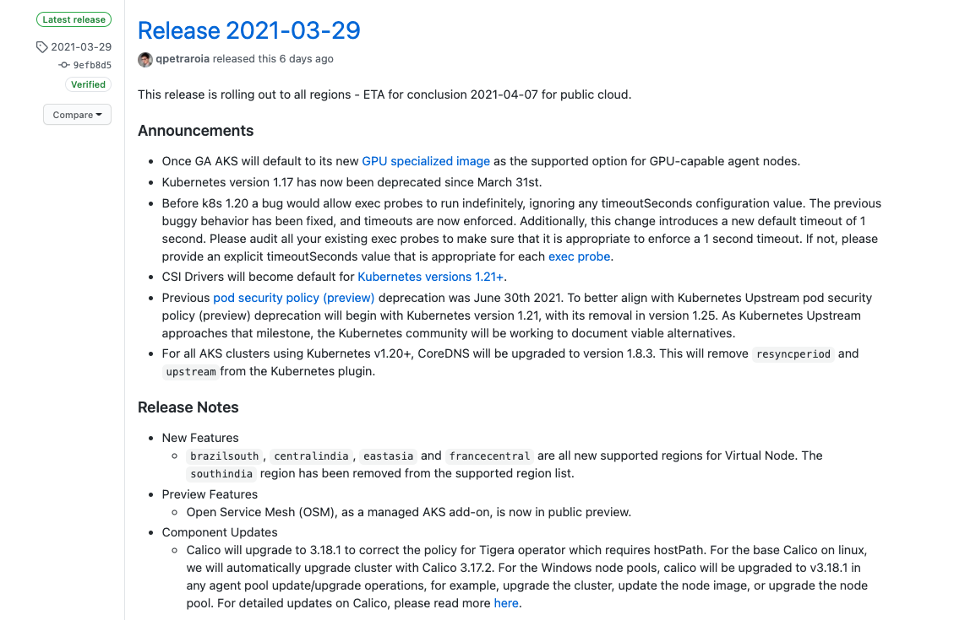
AKS Release Notes
K8s 1.17 deprecation (3/31)
CSI Drivers will be default for K8s 1.21+
Change in PSP (preview) deprecation

Slide 7

Open Service Mesh AKS add-on Public preview
CNCF sandbox project
Built on CNCF Envoy project
Implements Service Mesh Interface
Provides traffic shifting, mTLS, access control policies, monitoring, etc.
Open Service Mesh (Preview) - Azure Kubernetes Service | Microsoft Docs

Slide 8
Ecosystem updates
KubeCon + CloudNativeCon EU 2021
Virtual
May 4-7
$75
Secret Store CSI Driver session on Wednesday May 5th at 13:10 - 13:45 CEST
On March 18th, a formal proposal was submitted to CNCF for adding Dapr as an incubation stage project
KubeCon + CloudNativeCon NA 2021 (Oct 12 - 15)- CFP due by May 23rd
Open Policy Agent achieves graduate status from the CNCF!!!!! OPA integrates with Gatekeeper to provide a K8s-native experience for admission policy enforcement and auditing
Flux voted to move from sandbox to incubating
https://microsoft.sharepoint.com/teams/cn-talk/

Slide 9
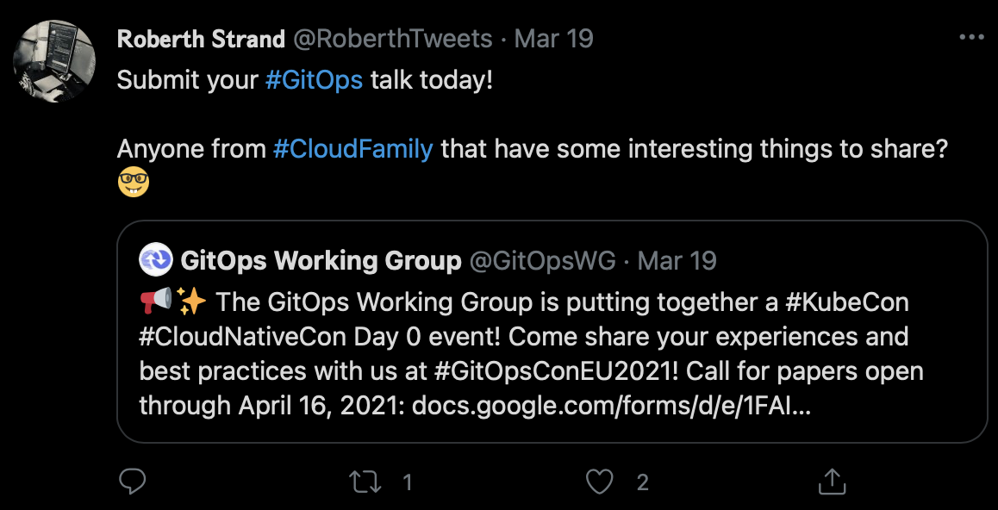
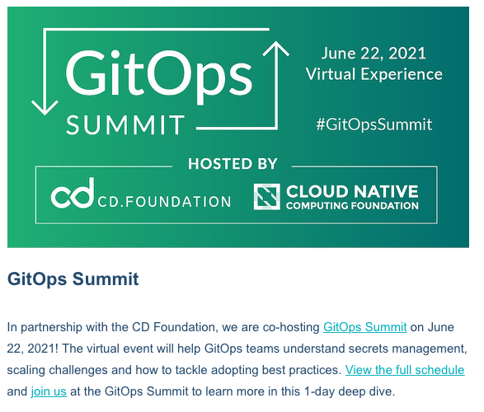
Inaugural GitOpsCon CFP through April 16th

Slide 10
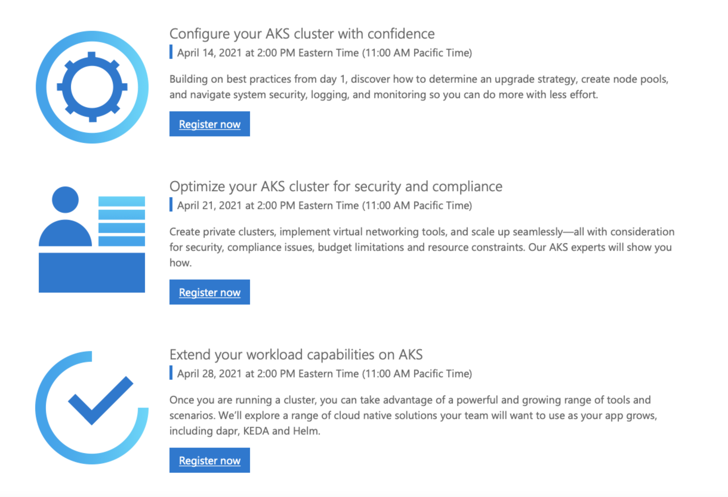
Cloud Native GBB 3-part Webinar for customers approaching
Series landing page

Slide 11
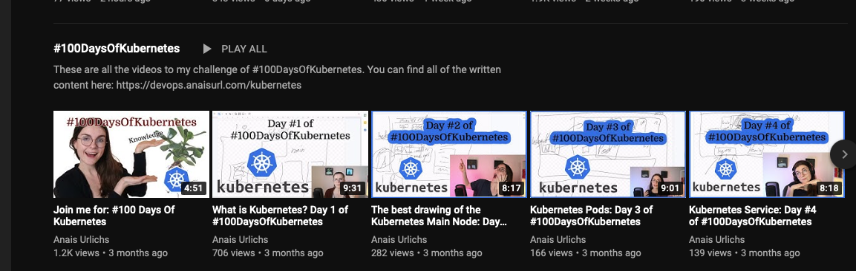
Resources
100 days of Kubernetes
Modern CD for K8s devs
10 predictions for cloud native in 2021 - Keynote, The DevOps Conference
- Cloud-Native is about culture, not containers
Notes:
https://www.youtube.com/playlist?list=PLWnens-FYbIpUpmiiNYfkqTZQUYppGMFV
https://www.notion.so/DevOps-Diary-2e5c82e48d374442858fc8295070a4b8
https://dev.to/gabrieltanner/modern-continuous-delivery-on-kubernetes-for-developers-5chf
https://www.oicheryl.com/2021/03/23/10-predictions-for-cloud-native-in-2021-the-devops-conference/ == Cheryl Hung VP ecosystem for CNCF
https://www.infoq.com/articles/cloud-native-culture/

Slide 12


Bridge to Kubernetes
Nick Greenfield
Program Manager
Lorenzo Lodi Rizzini
Software Engineer

Slide 13
Agenda
Bridge to Kubernetes Overview
How it works
Demo
Recent Feature Updates
Roadmap
Q&A

Slide 14
Bridge to Kubernetes
Value Prop
Debug and test code changes in the context of the larger application.
Solution
Client-side tool integrated into Visual Studio & VS Code
Run and debug microservice code on your development workstation, while connected to your Kubernetes cluster with the rest of your application or services.

Slide 15


Azure Kubernetes Service
Database API
MongoDB
Developer Workstation
You
Stats API
Frontend
Stats API
http://todoapp.nip.io
RabbitMQ Queue
Stats Workers
Redis Cache

Slide 16
Bridge to Kubernetes
Simplifies microservice development
Eliminate the need to manually source, configure and compile external dependencies
Develop applications faster
Sidestep operational complexities of building and deploying code into the cluster to test and debug
Debug and test end-to-end
Route traffic from the cluster to development workstations and back seamlessly
Work in isolation in a shared development environment
Work in a private “sandbox” environment by routing specific traffic locally.

Slide 17
Isolation Mode
Azure Kubernetes Service
Database API
MongoDB
Developer Workstation
You
Stats API
Frontend
Bridge Agent
Stats API
http://nickg-1234.todoapp.nip.io
RabbitMQ Queue
Stats Workers
Redis Cache

Slide 18
Demo

Slide 19
Recent Updates
Bridge to any Kubernetes cluster (local, remote, on-prem)
Integration with the VS Code Kubernetes extension
Support for Managed Identity
Decoupled “Bridge” and “Debug”
Admin-less solution using Kubernetes service ENV variables
Support for multiple “Bridge” connections in parallel
Support for services backed by multiple replicas

Slide 20
Roadmap
Redirect to a service running in a container
Compatibility with remote dev environments (e.g., Codespaces)
Compatibility with Dapr enabled clusters
Support for debugging a new service
CLI

Slide 21
Q&A

Slide 22
Getting Started / Reaching out
Email: BridgeToKubernetesTalk@Microsoft.com
YouTube Demo Video: https://aka.ms/bridge-demo
Getting Started Docs
VS Code
Visual Studio
Twitter: @BridgeToK8s
GitHub Repo: https://aka.ms/mindaro-repository

